Slide 1
Preparing for a Job Interview
Business Information Systems– 420-E01
References:
Business Communication Essentials, Ch 14

Slide 2
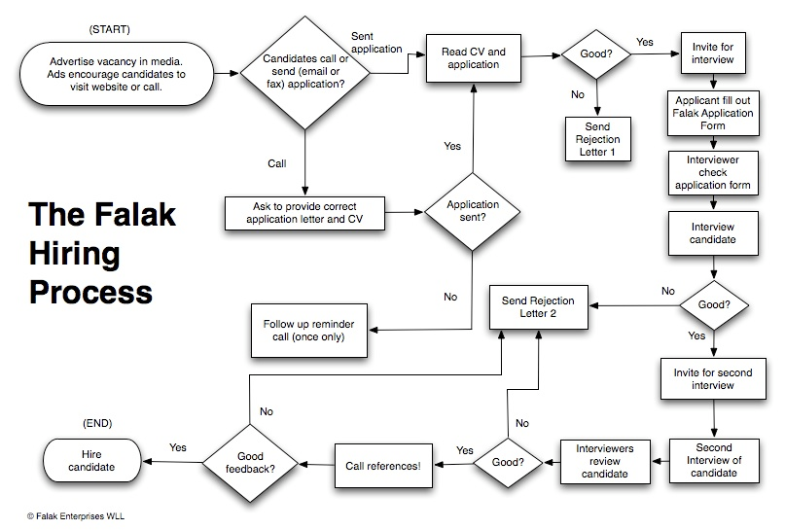
Notes:
Typical hiring process.
Show where resumes and cover letter comes in -> get you to the interview
In Comp Sci, also https://codility.com/

Slide 3
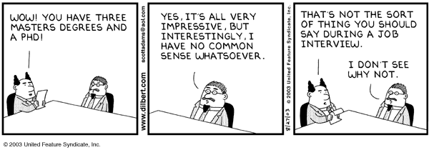
Notes:
Early on in your career you don’t have a lot of experience to stand on, you have to sell yourself on raw abilities, skills and attitudes

Slide 4
Common Types of Interviews
Structured
The interviewer asks a series of questions in a predetermined order.
Open-ended
The interviewer adapts his or her line of questioning based on the answers you give and any questions you ask.

Slide 5
Number of Interviewers
Interviews can be one-on-one or panel interviews.
In a panel interview, you meet with several interviewers at once.
Try to make a connection with each person on the panel.

Slide 6
Behavioural Interviews
Questions are asked to relate specific incidents and experiences from your past.
The interviewer is looking for you to provide specific examples of a situation.
Very popular interview style, which tends to be a better predictor of fit in a company.
These are often difficult for students, because you don’t have much experience to draw from. But, you will still get asked these types of questions.

Slide 7
How to Answer Behavioural Questions
Describe a specific situation
Explain what your role was
Explain what actions you took
Describe the positive result of your actions

Slide 8
Example Behavioral Questions
Describe a situation where you had to persuade someone to do things your way.
Give an example of a difficult situation you have faced and how you handled it.
Give an example of a time when you used good judgement & logic in solving a problem

Slide 9
Steps to Prepare for a Job Interview
Learn about the organization
Look at their website to see what they do, where they are located
Re-read the job description to understand the key attributes they are looking for
Prepare answers to common questions
Plan questions of your own
You will look foolish if you can not ask some intelligent questions about the organization/position

Slide 10
Steps to Prepare for a Job Interview
Practice
The more interviews you have, the easier they become. Take every interview you can get.
Take part in mock interviews
Present a professional image
Looks count – not in your physical features, but in the way you present yourself.

Slide 11
In Summary…
Be prepared!
I

Slide 12

Asking Questions
What kinds of questions should you ask in a job interview?
Should you ask about salary?

Slide 13
What Should I Wear to an Interview?
Guys: dress pants, button up dress shirt, tie, dress shoes
Girls: dress pants or skirt, blouse or some kind of dressy shirt, dress shoes
Don’t forget about the shoes…
It is important that you feel comfortable and confident in your outfit. Wear something that you like and that makes you feel good about yourself.
Personal grooming is part of your “dress”. Get a haircut. Shower. Have clean fingernails. Don’t wear perfume or aftershave.

Slide 14
What Should I Bring to an Interview?
A nice looking folder or portfolio case that contains:
A copy of your resume and cover letter
A copy of the job description
Your list of questions
A bottle of water

Slide 15
How Early Should I Arrive?
Don’t be late!
If you are going to the employer’s office for your interview, give yourself lots of time to find the place and account for bus/parking issues.
Be there about ten minutes early
If you are having an interview at the College, arrive 5 minutes early and just wait outside the door.

Slide 16
While You Are Waiting…
Review the job description & your questions.
Go to the washroom before the interview, and make sure you have had something to eat too!
Turn off your cellphone.

Slide 17
Starting an Interview
Shake the interviewer(s) hand – firm, friendly handshake.
Don’t give a wimpy handshake, but also don’t break their hand.... It’s their first impression of you.
SMILE!
Thank them for taking the time to interview you.
If they have come to the College for an interview, thank them for coming here.
Wait for them to show you where to sit.

Slide 18
First Impressions & Body Language
Stand up /sit up straight
Initiate and maintain eye contact
Smile!
Be enthusiastic.
Don’t fidget. Don’t shake your leg. Don’t tap your foot. Don’t play with your hair or jewellery. Hold on to your water bottle/portfolio to prevent you from fidgeting.
Don’t chew gum.

Slide 19
Dealing with Nerves
You will be nervous – everyone is, and interviewers know that. The key is to make sure that your nerves don’t prevent you from communicating.
If you find yourself really nervous, take a few deep breaths.

Slide 20
How to Answer Questions
Try to answer every question with a positive, upbeat answer. Demonstrate that you are an eager, hard working person.
Never give one word answers. Employers are looking to assess your communication skills. Explain what you mean, give examples, etc.
Be honest. Don’t make stuff up – it will show.

Slide 21
How to Answer Questions
Be positive – don’t point out negative stuff.
If you don’t know the answer, then admit it.
Don’t make up an answer.
If it is a problem solving type question, then say that you don’t know, but try and tell them how you would figure out the answer.

Slide 22
Ending the Interview
Shake hands
Thank the interviewer(s) for their time.
If you really want the job... tell them that!

Slide 23
Traits Interviewers Don’t Like to See
Poor personal appearance
A know-it-all attitude
Inability to express ideas clearly
Poor preparation for interview
Lack of enthusiasm
Lack of confidence
Failure to participate in extracurricular activities
Overemphasis on salary
Poor scholastic record
Tendency to make excuses
Evasive answers
Poor manners
Lack of social skills
Marked dislike for schoolwork
Failure to look interviewer in the eye
Weak handshake

Slide 24
Other tools in the pipeline
online assessment of coding ability
Given a problem, choose language, code and test within web browser
Compiles and automatically analyses and tests your program providing a score for the employer
Employer can see a playback to determine how you coded and watch your strategy
i.e Codility.com
On-site testing
Personality/behaviour quizzes
Technical quizzes

Slide 25
One Last Thing
Your online presence can prevent you from getting a job.
Google & Bing yourself
Make sure your Facebook profile is open only to your friends.
Check your Instagram settings, and any other social media sites that you use.

